Slide 1
New Jersey Return Entries in TaxSlayer State Section
NJ 1040 Instructions
NJ Special Handling Document on TaxPrep4Free.org
www.state.nj.us/treasury/taxation
NJ 1040-Lines 30, 45

Slide 2
NJ Return – Mostly Filled in Already
Most information on NJ return is already filled in by the time you finish Federal return
Most fields are automatically calculated from Federal entries
E.g. – most income
Sometimes you must signify special NJ tax treatment by using fields on Federal screens
E.g. – amount of interest on US Savings Bonds you want subtracted from state income entered on Federal Interest screen

Slide 3
Entries in the TaxSlayer State Section
In certain cases, you should have noted specific information on the NJ Checklist as you were entering data in Federal section so that you would not forget to enter necessary adjustments now that you are up to State section
E.g. – property taxes, military pension
There are a few situations which are unique to NJ so they will also require entry in the TaxSlayer State section
Use tax due on out-of-state purchases
Rent
NJ refund to apply to next year return
NJ estimated payment vouchers
Notes:
The assumptions here are:
You have already completed the prior sections in the Main Menu (i.e. – Basic Information, Federal section, Health Insurance)
You have already input any necessary adjustments for differences between Federal and NJ tax law that are entered on the Federal screens, such as:
Interest taxable on the Federal that is tax-exempt for NJ
Interest tax-exempt on the Federal that is taxable for NJ
You were capturing information on the NJ Checklist that might need NJ adjustments as you were completing the Federal screens
Checklist ensures that you don’t forget to enter items in the State section where NJ tax law differs from the Federal
Checklist also captures items that are unique to NJ

Slide 4
NJ Checklist – Page 1
Notes:
Note that the NJ Checklist is in the same order as the topics in the State Section Menu (Section titles are in the middle of the blue lines dividing sections)

Slide 5
NJ Checklist – Page 2

Slide 6
TS – State Section Menu
Notes:
This is the sub-menu in the State section that you will use to enter any adjustments necessary on the NJ return

Slide 7
TS – Basic Information
TaxSlayer started the NJ return for you after you entered the taxpayer Personal Information in the Basic section by asking 4 questions:
Municipality code
Dependent health insurance coverage
Gubernatorial elections fund
NJ PINs
Depending on circumstances, some additional basic information may be needed

Slide 8
TS - Basic Information Entered When NJ Return Was Started State Section \ Edit \ Enter Myself \ Basic Information
State information entered in Personal Information section
Municipality code
Dependent health insurance coverage
Gubernatorial elections fund
NJ PINs

Slide 9
TS - Basic Information - Additional Inputs That May Be Needed
(cont’d)
May need to answer some additional Basic Information questions, depending on the taxpayer’s circumstances:
Disabled taxpayer/spouse (for additional exemption) *
Full-time college students < age 22 (for additional exemption)
Request for NJ tax forms to be mailed next year
Federal/NJ extensions filed
Need to attach death certificate for deceased person on return
Part-year NJ resident
Information to answer these questions should have been captured in the NJ Checklist Basic Information section as you progressed through the Interview and previous TaxSlayer sections
* YES answer to this disability question results in an additional exemption on NJ 1040. Disability question also asked in Subtractions from Income section. YES answer there might qualify taxpayer for pension exclusion (requires disability as per SSA guidelines)

Slide 10
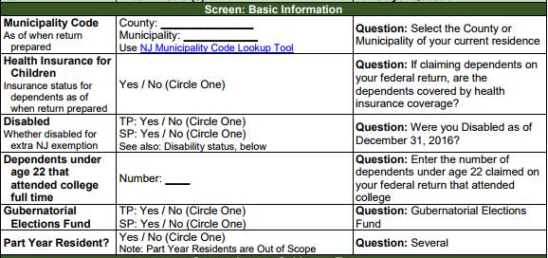
NJ Checklist – Basic Information Section
Tells you what line on TaxSlayer screen to use to enter the information

Slide 11
TS – Basic Information – Additional Inputs That May Be Needed State Section \ Edit \ Enter Myself \ Basic Information
Disabled as of 12/31
# of extra exemptions for college students < 22
Death certificate attached
NOTE: Do not need to answer any specific additional question unless applicable
to that return
Notes:
NJ grants an extra exemption if taxpayer or spouse is disabled
On NJ return, parents claim exemption for college student if claimed on Federal; can also claim an extra exemptions on NJ for all full-time college students < 22

Slide 12
TS – Income Subject to Tax
Certain types of income are handled differently in NJ than on the Federal return and, therefore, may need to be adjusted on the NJ 1040
Taxable scholarships – taxable amount may be different for NJ
Medicaid waiver payments on W-2
Military pensions - not taxable for NJ
Disability pensions - not taxable for those < 65 for NJ
Taxable and excludable portions of pensions - reported separately on NJ 1040 Lines 19a and 19b
NJ taxable amount of a retirement distribution may be different than Federal taxable amount (e.g. – NJ contributory pensions, 403b/457b/TSPs, IRA withdrawals, distributions eligible for NJ 3-year rule)
Public safety officer insurance premiums – up to $3,000 excluded from Federal pension, but included in NJ taxable pension

Slide 13
TS – Income Subject to Tax
(cont’d)
Certain types of Other Income on Federal 1040 Line 21 are handled differently on NJ 1040 Line 25
Cancellation of credit card debt - not taxable in NJ (now automatically handled by TaxSlayer)
PTR recovery - not taxable in NJ
Homestead Benefit recovery - not taxable in NJ
Gambling winnings are netted against losses and the net is reported on NJ 1040 Line 23, not as Other Income on Line 25
Since the Federal Other Income amounts on 1040 Line 21 flow through to NJ Other Income Line 25, may need to add or subtract from Line 25 to reflect the different tax treatment

Slide 14
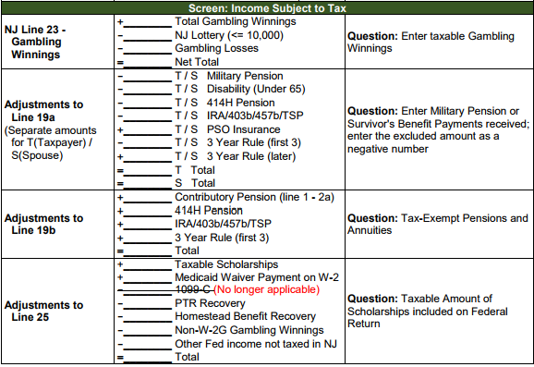
NJ Checklist – Income Subject to Tax Section
Tells you what line on TaxSlayer screen to use to enter the information

Slide 15
TS – NJ Taxable Gambling Winnings State Section \ Edit \ Enter Myself \ Income Subject to Tax
+ Gambling winnings
- NJ Lottery Winnings (</= $10K)
- Gambling losses
= Taxable gambling winnings for NJ

Slide 16
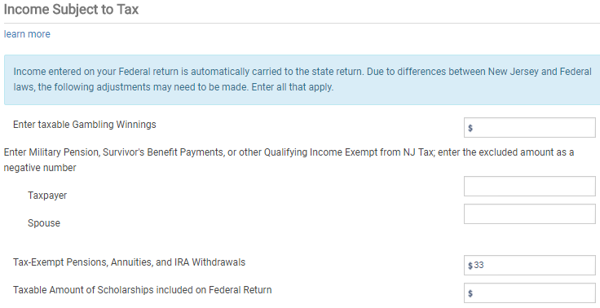
TS – Military Pensions on NJ 1040 State Section \ Edit \ Enter Myself \ Income Subject to Tax
Military pension amounts for taxpayer
& spouse (enter as negative amount
on “Military Pension” line); will be sub-
tracted from NJ 1040 Line 19a pension
income

Slide 17
TS – Disability Pensions for People Under 65 on NJ 1040 State Section \ Edit \ Enter Myself \ Income Subject to Tax
Disability pension amounts for taxpayer
& spouse if under 65 (enter as negative
amount on “Military Pension” line); will be
subtracted from NJ 1040 Line 19a pension
income

Slide 18
TS – NJ Tax-Exempt Pensions and Annuities on NJ 1040 Line 19b State Section \ Edit \ Enter Myself \ Income Subject to Tax
Tax-exempt pensions and annuities

Slide 19
TS – Public Safety Officer Insurance Premiums Excluded from Federal Pension, but Included in NJ Taxable Pension State Section \ Edit \ Enter Myself \ Income Subject to Tax
Public Safety Officer Insurance Premiums
(enter as positive amount on “Military Pension” line); will be added to NJ 1040 Line 19a pension
income

Slide 20
TS – Adjustments to Other Income on NJ 1040 Line 25 State Section \ Edit \ Enter Myself \ Income Subject to Tax
Adjustments to NJ 1040 Line 25 Other Income (enter as a positive or negative amount on “Taxable Amount of Scholarships included on Federal Return” line)

Slide 21
TS – Subtractions from Income
Adjustments to capital gains for securities that are exempt from NJ tax
Medical insurance premiums that are pre-tax for Federal are considered after-tax for NJ
Cannot be claimed as medical expense for Federal, so not included in medical expenses that flow through to NJ 1040
Can be claimed as medical expense for NJ, so must be added to medical expenses already on NJ 1040 Line 30

Slide 22
TS – Subtractions from Income
(cont’d)
Second question about disability on NJ Checklist
First disability question in Basic Information section is used to determine eligibility for additional exemption
Second question is used to determine if taxpayer is eligible for NJ pension exclusion (even if under age 62)
Answers to the 2 disability questions could be different since pension exclusion requires disability as per SSA guidelines

Slide 23
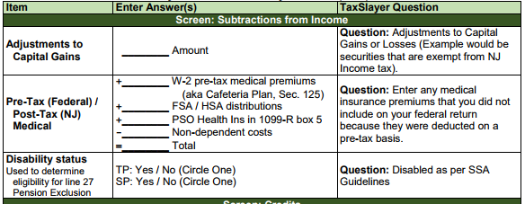
NJ Checklist – Subtractions from Income Section
Tells you what line on TaxSlayer screen to use to enter the information

Slide 24
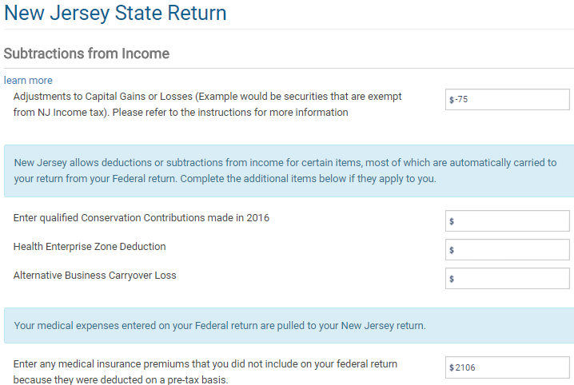
TS – Adjustments to Capital Gains State Section \ Edit \ Enter Myself \ Subtractions from Income
Adjustments to capital gains or losses

Slide 25
TS - Federal Pre-Tax/NJ After-Tax Medical Insurance Premiums State Section \ Edit \ Enter Myself \ Subtractions from Income
Enter any pre-tax medical premiums included in NJ income on W-2

Slide 26
TS – Disability for Pension Exclusion State Section \ Edit \ Enter Myself \ Subtractions from Income
Disabled as per SSA Guidelines
for taxpayer & spouse; if Yes, may be
entitled to Pension Exclusion even
if under 62

Slide 27
TS – NJ Credits
Credits available through NJ
Property tax credit/deduction (details covered in Itemized Deductions module)
Answer question as to whether taxpayer meets property tax eligibility requirements (if answer is NO, taxpayer will not receive credit)
Enter appropriate property taxes on principal residence and/or 18% of rent
Use scratch pad on TaxPrep4Free.org to document calculation
Answer question as to whether taxpayer was a homeowner in 2016
If homeowner, must also enter block and lot data

Slide 28
TS – NJ Credits
(cont’d)
Credits available through NJ
Credit for taxes paid to another state
See Special Topics documents on TaxPrep4Free.org Preparer page
Sheltered workshop tax credit
Out of Scope

Slide 29
NJ Checklist – Credits Section
Tells you what line on TaxSlayer screen to use to enter the information

Slide 30
TS – NJ Credits Menu State Section \ Edit \ Enter Myself \ NJ State Return \ Credits
Disabled as per SSA Guidelines
for taxpayer and spouse
Property tax credit/deduction
Credit for taxes paid to another state

Slide 31
TS – Property Tax Credit/Deduction State Section \ Edit \ Enter Myself \ Credits \ Property Tax Credit/Deduction
Meet property tax eligibility requirements
Property taxes paid &/or 18% of rent
Homeowner in 2016
Block & lot info

Slide 32
Use Tax Due on Out-of-State Purchases – NJ 1040 Line 45
NJ 1040 Instructions
From NJ1040 Instructions:
“When you purchase taxable items or services to be used in New Jersey but do not pay sales tax, you owe use tax. This commonly occurs when purchases are made on the Internet, by phone or mail order, or outside the State from sellers who do not collect New Jersey sales tax. The New Jersey use tax rate is the same as the sales tax rate: 7%. If you paid sales tax to another state at a rate less than 7% on a purchase that would have been taxed in New Jersey, you owe use tax based on the difference between the two rates. …”
Notes:
Must ask the client if they had made purchases out of state, on Internet, by phone or by mail order
Only for items that would have been taxable in NJ (e.g. - not food)
If not “used” in NJ, then no NJ Use Tax due (e.g. - TV used in cabin in Maine)
Penalties for not paying Use Tax can be surprisingly severe

Slide 33
Use Tax Due on Out-of-State Purchases – NJ 1040 Line 45
NJ 1040 Instructions
(cont’d)
For total of items/services costing < $1,000 each
With receipts, can use 7% (6.875% for 2017) of purchase amount(s) (minus any sales tax paid) OR
Can use Estimated Use Tax Worksheet to estimate Use Tax due based on income
For each item/service costing $1,000 or more
Must calculate exact Use Tax due
Use Tax due for these items is in addition to total for items/services costing < $1,000 each
If sales tax < 7% (6.875% for 2017) was paid, must pay difference
See Worksheet H in NJ 1040 Instructions for more detail
Calculate amount due using NJ Use Tax Due link on TaxPrep4Free.org Preparer page
Enter in State section \ Edit \ Enter Myself \ Tax

Slide 34
NJ Checklist – Tax Section
Tells you what line on TaxSlayer screen to use to enter the information

Slide 35
TS - Use Tax Due on Out-of-State Purchases State section \ Edit \ Enter Myself \ Tax
Use tax due, based on calculations on NJ 1040 Worksheet H – Use Tax
on TaxPrep4Free.org Preparer page
Notes:
Can use scratchpad on TaxPrep4Free.org to document this if necessary

Slide 36
Use Tax Due on Out-of-State Purchases – NJ 1040 Line 45
Use tax due

Slide 37
NJ Checklist – Tax Section
Tells you what line on TaxSlayer screen to use to enter the information

Slide 38
TS – Payments Amount of NJ Refund to Apply to Next Year Return State section \ Edit \ Enter Myself \ Payments
Amount of NJ refund to apply to next year return

Slide 39
TS – Miscellaneous Forms Menu State section \ Edit \ Enter Myself \ Miscellaneous Forms
Estimated Payment Vouchers
Amount of NJ refund to apply to next year return

Slide 40
TS – Miscellaneous Forms Menu State section \ Edit \ Enter Myself \ Miscellaneous Forms \ Estimated Payment Vouchers, Form NJ-1040-ES
Enter amount of estimated taxes
to be paid each quarter next year

